Slide 1

Organathon Foundation QUO-VADIS
a pro-bono initiative
Dr Ajay K Sachdev

Slide 2
QUO-VADIS
XENOTRANSPLATATION ( WHY PIG? )
CURRENT SCENARIO
STEM CELL-BANKING (www.cordlifeindia.com)
ORGAN DEVELOPMENT ~80 Diseases treated
ORGAN FACTORY/SHOW ROOMS ?? – FACT & NOT A FICTION

Slide 3
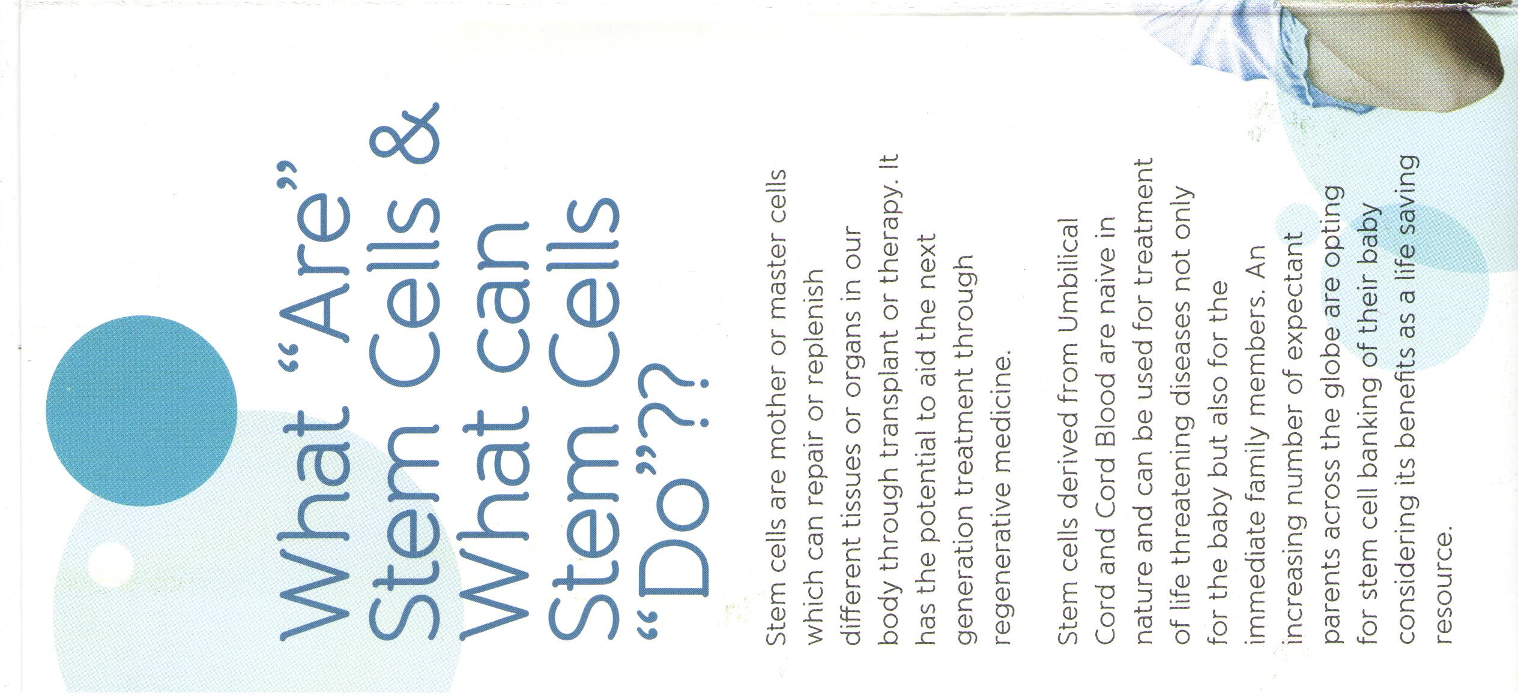
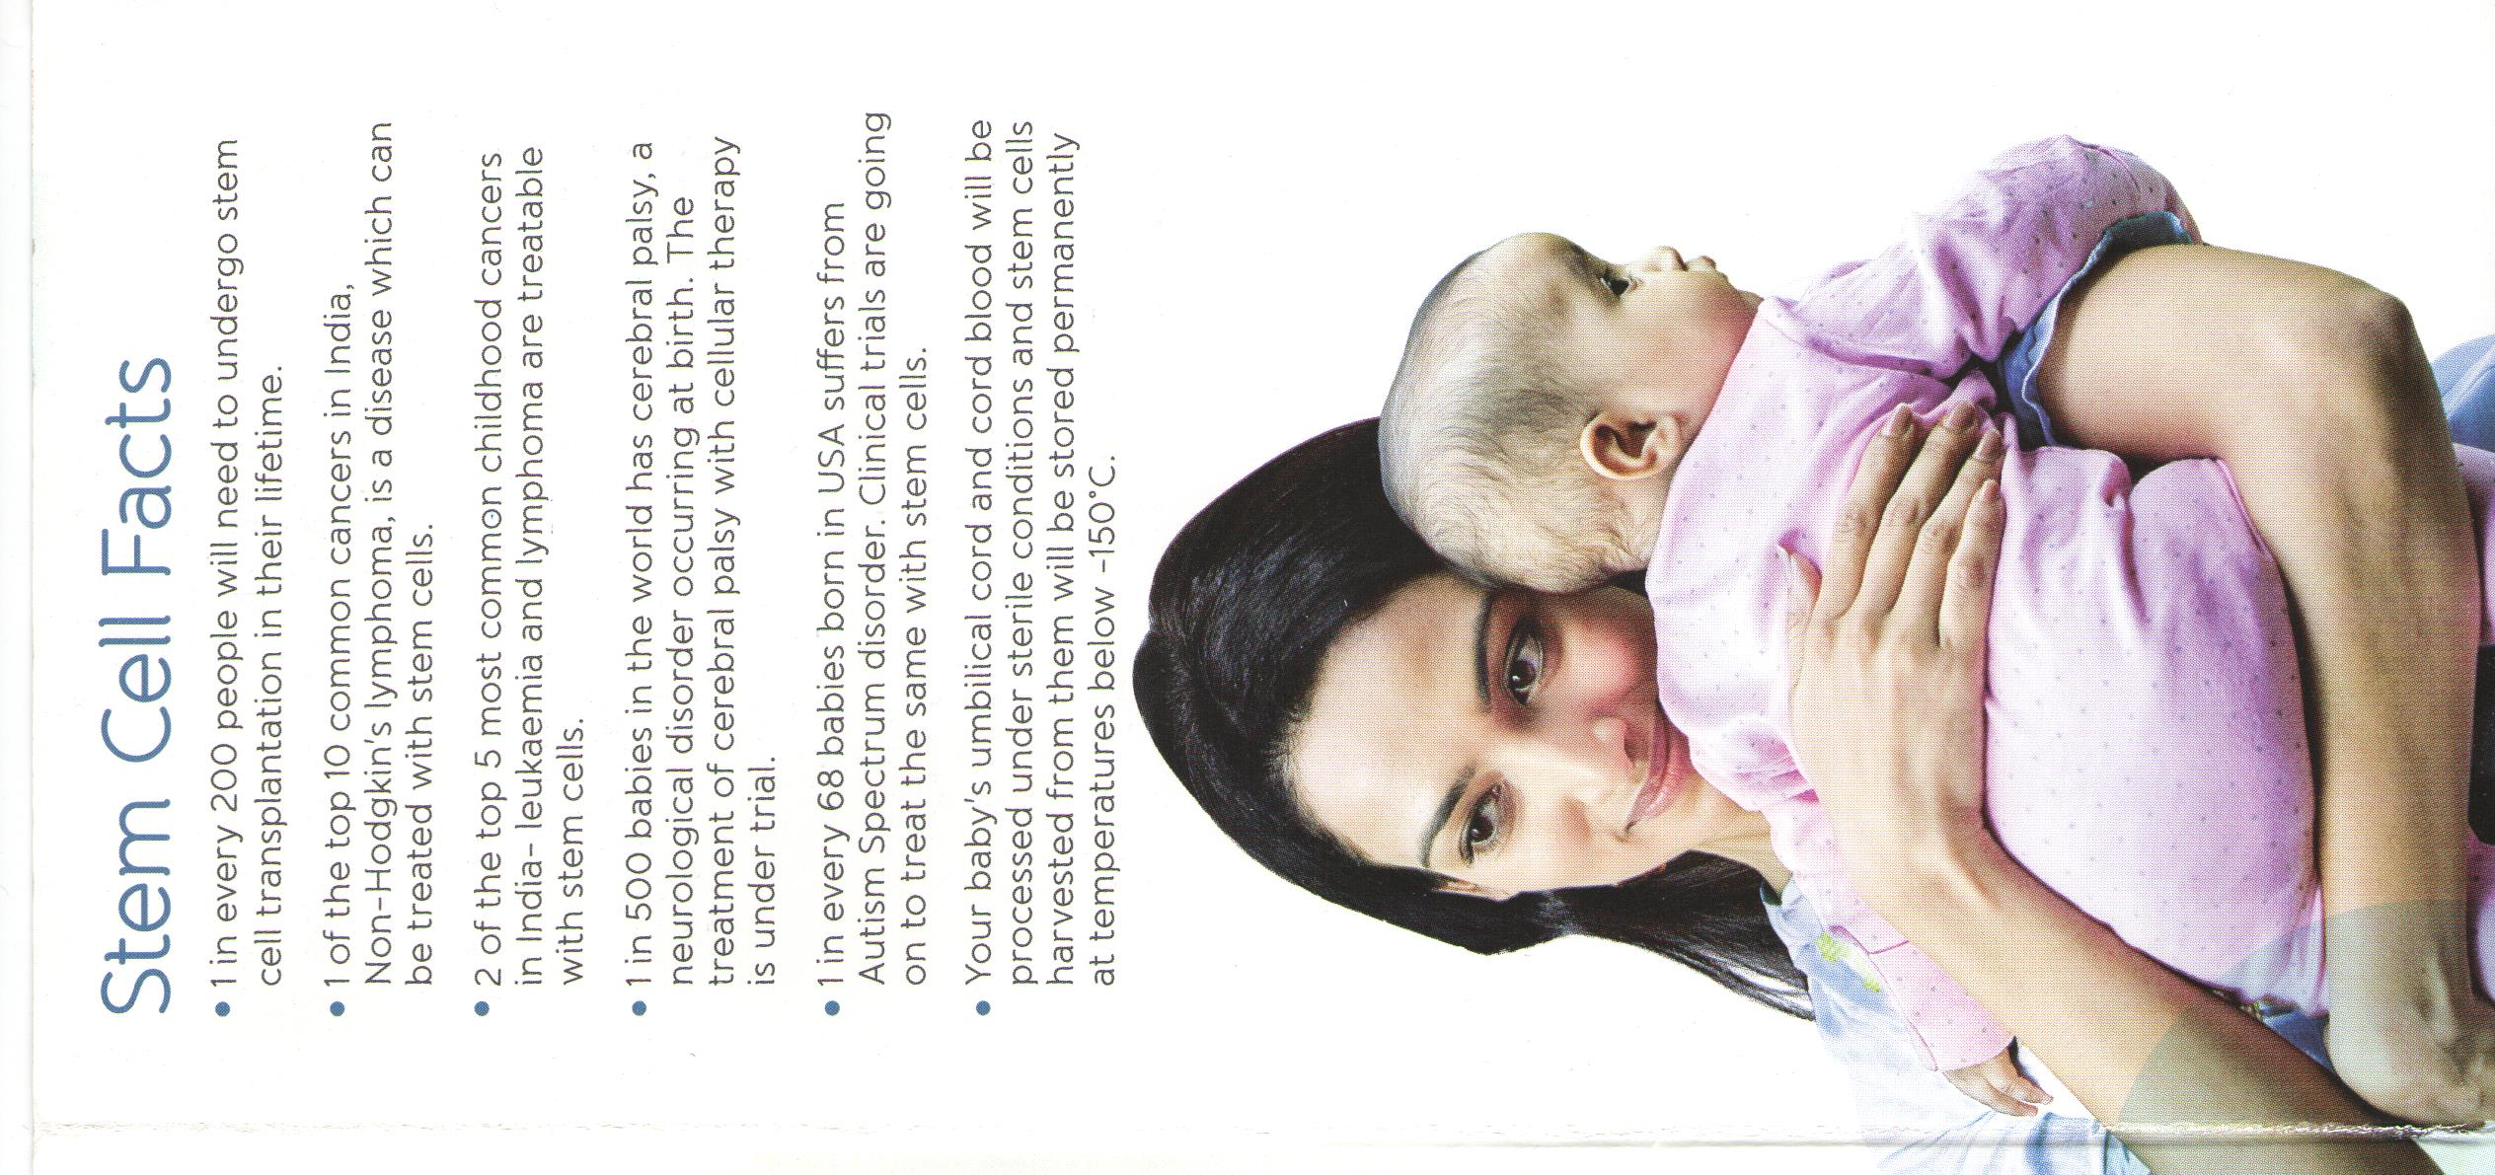

Slide 4
What we are ?
We are a Public Trust
Registered on 17.2.2015
Registration number :IN-DLI-16255329840893O
Registered with National jurisdiction
Regd. Office : Delhi
Corporate office : Gurgaon
PAN No.-AAATO5228Q
Organathon Foundation trademark has been registered under 3 heads :
Health
Education
Social Work
NOTE:- IT EXEMPTION UNDER 12A & 80G

Slide 5
Who we are ?
Settler & Chief Managing Trustee : Dr Ajay Sachdev, MBBS; MS; PhD (G.I Surgery), a senior, experienced & reputed GI surgeon at Delhi NCR
Board of Trustees : Stalwarts in different fields , besides Dr Sachdev
Mr R Venkatramani, Senior Advocate, Advisor Legal,Member - Law
Commission
Dr Mohsin Wali, senior Physician & Physician to the President of India;
Dr. T D Dogra – Ex Dean AIIMS & Currently Pro Vice Chancellor
Dr Prakash Khanduri – Crdited of doing first liver Tx in India
Advisory Board : Stalwarts in different fields
Jagdish Mukhi, former Finance Minister of Delhi, Chief Advisor;
Dr Prakash Khanduri, Advisor medical;
CA- H N V Associares
Mr Venkatramani, senior Advocate, Advisor Legal
Mr Virmani, Advisor public relations;

Slide 6
What is Organ Donation
The process of removing an organ or tissue from live, dead or recently dead person, to be used on another person
The person who donates is Organ / tissue Donor
The person who receives is Organ / tissue recipient

Slide 7
Types of Organ Donors
Living person : near-relative of recipient
Living person : not a near-relative of recipient
Cadaver : Brain stem dead person with a beating heart
Cadaver : Cardiac death with non beating heart

Slide 8
Cadaver transplantation
Brain dead
Consent given
Organs retrieval
Transportation to Transplant centre
Consent not given
Transplant Abandoned
Transplantation executed

Slide 9
Any difference in the outcomes ?
Graft survivals & acute rejections are comparable between live & cadaver kidney transplantations
Slightly better compatibility in live related donors as compared to cadaver donors
No risk or loss to cadaver as compared to liver donor
Multi-organ transplantation feasible from a single cadaver donor

Slide 10
Difference between Live & Cadaver transplantation
Live
Graft survival & acute rejection better
Compatibility slightly better
Some risk or loss to Donor present
Single organ donation possible
Commercial trading of organs an important issue
Cadaver
Graft survival & acute rejection slightly poor
Compatibility slightly poor
No risk or loss to Donor at all
Multi organ donation feasible (approx. 50 organs & tissues)
Commercial trading of organs not an issue
Can be sporadic activity
Can be a mass activity

Slide 11
Organs & tissues which can be donated
Brain dead
Kidney
(2 patients)
Liver
Pancreas
Heart
Cornea
(2 patients)
Tissues
(skin, bones, ligaments, heart valves etc)
Lungs-2

Slide 12
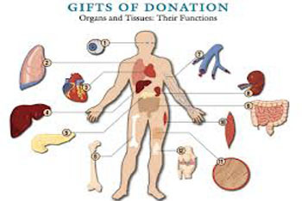
Common organs & tissues available for cadaver donation

Slide 13
Cadaver organ Donation (some meaningful slogans)
Instead of taking organs to heaven, better to help create heaven on earth.
You can ‘live’ even after your death
Helps to carry your life beyond your death, through some fellow human beings
Virtually a life beyond death

Slide 14
Reasons for organ shortage
Lack of awareness in the public
Lack of sensitivity among the doctors, nurses & hospital managers, in hospitals dealing with critically ill patients
Myths related to religious beliefs
Fear, apprehensions & misunderstandings
Legal restrictions
Media hype about scandals involving organ trading
Other factors

Slide 15
Road Traffic accidents
WHO : road traffic accidents caused 1.25 million deaths worldwide in the year 2010. That is, one person is killed every 25 seconds.
In New Delhi, the frequency of traffic collisions is 40 times higher than the rate in London, Indian Economy. FK Publications. p. 457. ISBN 978-81-87140-37-5. Retrieved 3 May 2012.
In 2015, one person dies every 4 minutes in roads accidents in India, according to NGO 'Indians for Road Safety'. Murali Krishnan (29 April 2010). "India has the highest number of road accidents in the world". Deutsche Welle. Retrieved 3 May 2012

Slide 16
RTA- Statistics
In 1998, India had 1% of the world’s road vehicles and 6% of the world’s road accidents. These accidents have increased to 10% in 2006. The total number of road accidents is approx. 90000 per annum.
In nearly 40-50% of all fatal accidents, the leading cause of death is head injury
This implies that there is a huge potential for deceased organ donors in India from road traffic accidents alone- Brain dead (Cadaveric )
Even if 5%-10% of all these deceased patients become organ donors, there would be no requirement for a living person to donate an organ
(Legal and ethical aspects of organ donation and transplantation. Indian J Urol., 2009; 25(3): 348–355.).

Slide 17
Current Scenario
India-200000 people need a new Kidney /Year
-100000 people need a new Liver/ Year
BUT
ONLY 2-3 % of the demand for new Organs is met
While in western countries around 70-80 percent of people pledge their organs, in India only about 0.01 percent do so

Slide 18
? VIP Syndrome-fact or fiction
Mr Vilas Rao Deshmukh, a well known senior political leader, was listed as a hyper-ultra-critical case in need of a liver and kidney transplant and that put him ahead of over 200 patients registered. His actor son Riteish Deshmukh was registered as a part-liver donor, but doctors said the Congress leader needed a full liver which could only come from a brain-dead person.
"Had we got a liver he would have had a chance. Last night, a brain-dead donor died before we could transplant. Three donors were available today, but it was too late," said Dr K Ravindranath, Chairman of the Global Hospital Group.

Slide 19
AIIMS trauma centre study
Of 205 patients declared brain dead at the trauma centre in the past five years, only 10 were potential donors.
It admits over 6,500 patients every year, analysed the number of cadaver donations between September 2007 and August 2012.
90 percent of donors were middle-aged males. The cause of brain death in 70 percent of cases was injuries sustained in road accidents, 20 percent after falling from heights and 10 percent due to being gored by animals, particularly cows.
The average time recorded from certification of brain death to organ harvesting was 33 to 46 hours & this gap is 72-96 hours from time of accident to harvesting-Cause Multifactorial
the organs harvested were kidneys, hearts, heart valves, livers and corneas.
In case of live donations, it was mostly women who were donating their body parts like kidneys. The ratio of male versus female in live donations was around 20:80.

Slide 20
Some statistics
India (2009)
RTA cases : 4.22 lacs
Fatalities from RTA cases : 1.27 lacs
i.e, One RTA reported every minute and
One Death from RTA occurs every 4 minutes
Haryana
Population : 2.7 cr
15 to 59 age group : 56 % ie 1.5 cr
1 % of this group : 1.5 lacs

Slide 21
Focus on North Zone
Commendable work being done in South India
Why North Zone cannot do better esp when, there are more number of Transplant Centres and More number of Road Traffic Accidents in this Zone
NCR/Haryana is fast emerging as a Transplant State with lot of hospitals in public & private sector doing organ transplants
NCR-Haryana is part of the North Zone ROTTO, which maintains the regional transplant registry but there is no State registry for Haryana. It should start a SOTTO / HOTTO to cater to this State.

Slide 22
Our target
One percent of eligible population to pledge their organs per year. Initially in Haryana & North Zone. Later spread to other zones
One percent of all brain deaths to be converted to organ donation ( 0.05 % )
Education of the young population esp at school & college level about organ transplantation and the need for pledging organs
Sensitization of the doctors, care givers & hospital management -brain death & cadaver organ transplantation

Slide 23
Our Target-Contd…
Inclusion of Chapter on Organ Donation in the CBSC/NCERT
Tsunami Obesity- Childhood Obesity- NASH
Involvement of Politician- to decrease red tapism
Sensitisation of Police / Public to reduce gap-RTA to Harvesting & for Green Corridor
Involvement of other NGO /Clubs /Societies etc.
Others / Miscellaneous

Slide 24
National Organ and Tissue Transplant Organization (NOTTO)
NOTTO is a National level organization set up under Directorate General of Health Services, Ministry of Health and Family Welfare, Government of India.
It maintains a central registry for end stage organ failure patients, transplantation centers & procedures as well as pledging of organs and their conversions.
It controls the Regional Centres (ROTTO) and the State Centres (SOTTO)

Slide 25
Regional Organ and Tissue Transplant Organization (ROTTO)
Post Graduate Institute, Chandigarh
Punjab Haryana Himachal Pradesh Jammu & Kashmir Chandigarh Rajasthan Uttrakhand
Delhi / NCR ???

Slide 26
Voluntary cadaver donation
Opt in type : The donor gives consent to donate his organs
Opt out type : Anyone who has not refused is presumed to be willing to donate his organs.
In India, we follow the Opt in policy, though many people feel that we should adopt opt out policy to increase the number of cadaver transplants
Option Suggested-Inclusion in Driving License / Adhar Card for opt out option

Slide 27
Suggestions
Develop a culture of Pledging Organs for donations
Structured education of school & college students about organ transplantation and pledging of organs. A chapter on organ transplantation be included in the text books at different levels
Non Organ Transplant Retrieval Centers (NOTRC) :any hospital with > 50 beds and a working OT & an ICU should be declared NOTRC-OF Suggestion & for implementation – Protocol will be developed.
Brain death declaration to be done as per protocol. Retrieval of organs may be done by the local team or by the team from the transplant hospital. Transplant coordinators and grief counselors should professionally handle the situation
In MLC cases, the police needs to be sensitized to speed up the inquest proceedings, once the family has agreed for organ donation. Police should also facilitate the post mortem (may be performed in the same hospital where death has occurred) & handover of the body respectfully
While transferring a body from one State to another for the performance of last rites, NOC is required from the hospital & the police. This may be issued promptly.

Slide 28
Incentives & Misellanious
Public salutations & awards to the deceased persons who donated their organs (posthumously)
Presumption of consent (opt out system)
Development of SOTTO / HOTTO for Haryana,
We should undertake measures to reduce the incidence of organ failures (Multidisciplinary) approach. At the same time ensure that no such patient dies for want of an organ

Slide 29
Incentives & Misellanious
Family of Organ Donor be given priority in the waiting list, should they ever need organ transplantation in the future
We can have dedicated teams of air / surface ambulances (specially designed) for moving to a centre for organ harvesting and then for taking the organs to the destination hospitals via the green corridor / Drones, for transplantation
Which organ to go where is decided by the Central registry of the Nation /State / Region.

Slide 30
ORGAN TRANSPLANT- QUO- VADIS
Scientific Programme
Day-1
PARA ORGAN TRANSPLANT MEDICS
INAUGRATION
GUEST OF HONOR SPEECH
CHAIRMAN OF FOUNDATION SPEECH
Session-1( Police )
Sensitization / training of Police—How much,how offen& by what means ?
Protocol / SOP for above
Speech by CP/ DCP
E. Session-2 ( HRD )
Inclusion Syllabus / Chapter on Organ Transplantation
Lecture by VC Delhi University
Lecture by HRD Representative
F. Session-3
Harvested Organ transport by :-
Green Corridor—Police Perspective
By Drones—DRDO / IIT Speaker
Concluding Remarks ? Speaker
G. Session-4
Student Perspective—Principal DPS/AMINITY/ANY ?
Student Perspective—By a Student
H. Session-5
RTA / Brain related death Vs. Overall Incidence—SOPs -
whom to target ?
Nearest place to Harvest Organ-SOP & Ministry approval
By Which team ( OF team Vs. nearest Hospital team )&
where to transport as per Registry
Day-2 (Doctors)
1-Xenotransplantation—Debate
FOR / AGAINST
2-Current Perspective
A-Landmark publications during past 5 years that have significant impact on Surgical Policy of Organ Transplant & its outcome , Immunosupprerssant etc .
Liver
Kidney
Heart
Pancreas
Small Intestine
Lung
Uterus
B- Donor-Recipient matching- How much & How little( Organ Wise )
C- Pancreas Transplant Vs. Artificial Pancreas – Can we put the needles away ?
D-Small Bowel transplat—Current status &Where we are obstructed ?
E- Stem Cell-Current perspective & future role
F- Stem Cell Organ Cloning- Pros & Cons / Could we? Should we?
G-Cloning Human Organs for Transplant—Social Advantages
---Social Disadvantages
H-Stem Cell to Organ factory- Fact OR Fiction
I-Free paper Session
J-Posters hours
K-Meet your Professors
L-Transplant Society launch- including not only Medical team but also technicians,coordinators , staff nurses etc

Slide 31
Thanks…
www.organathonfoundation.org

